Slide 1
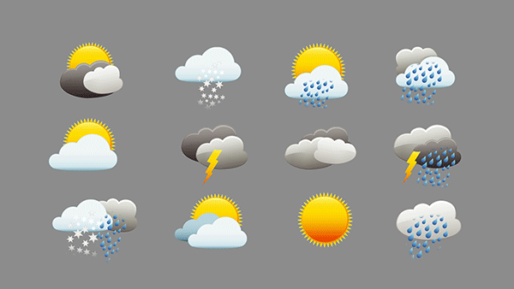

Weather Science
This Photo by Unknown Author is licensed under CC BY-NC-ND
Notes:
Today we will talk about weather science.

Slide 2
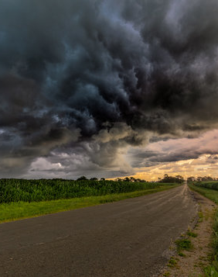
Today we will…
Discover what weather is.
Demonstrate how pressure affects weather.
Observe the weather outside.
Learn about the tools scientists use to measure weather.
Learn about the difference between Weather and Climate.
Notes:
In today’s Weather lesson we’ll talk about where and why weather happens, perform experiments on pressure, go outside to record weather data using weather instruments and a meteorologist notebook, learn about the tools scientists use to measure weather and the difference between weather and climate.

Slide 3
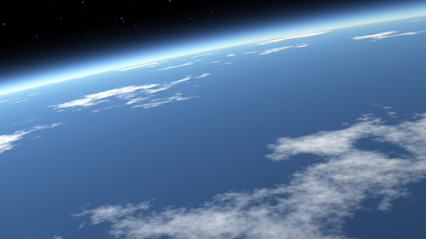
The Atmosphere!
Notes:
Look at this picture. Where does weather happen? In the atmosphere. What is the atmosphere? This is what the atmosphere looks like from outer space. It is like a blanket of gases that surrounds our planet. What do you know about the atmosphere? Why is it so important? Everyone take a deep breath. What did you just inhale? Atmosphere! This is the place that weather happens. Now we know where it happens, but what is weather?

Slide 4
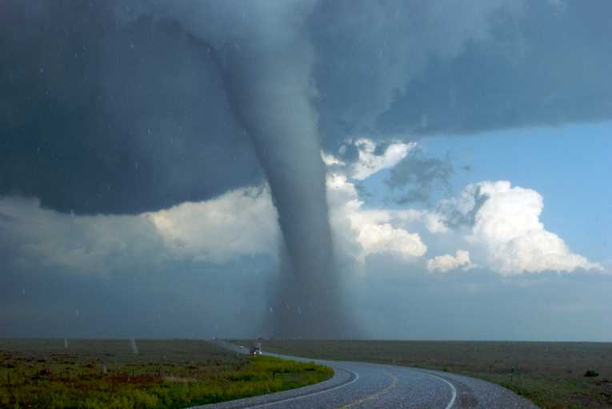

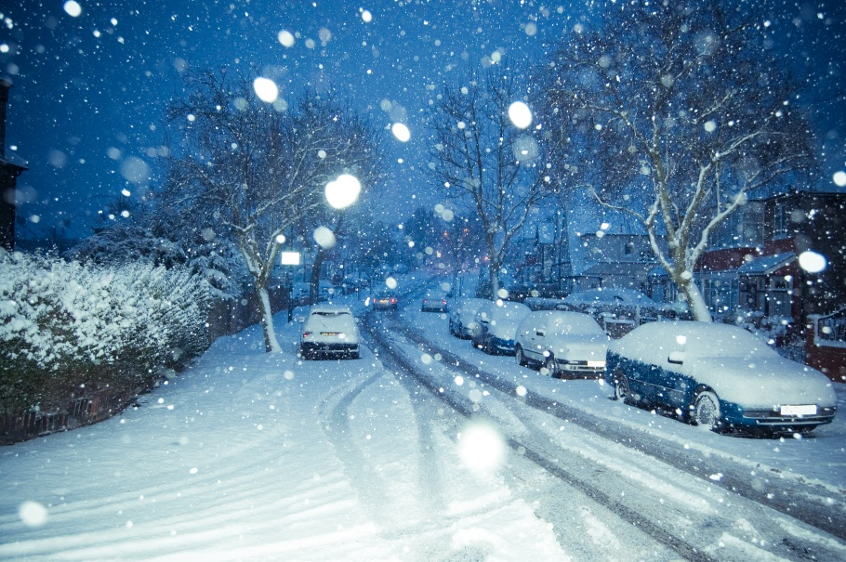
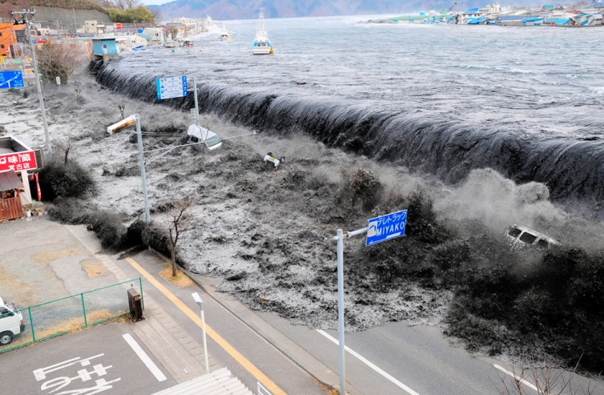
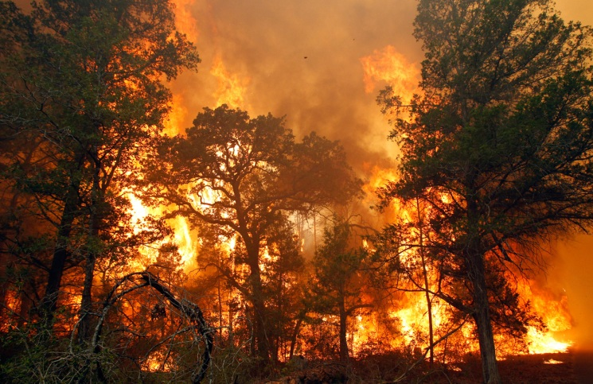
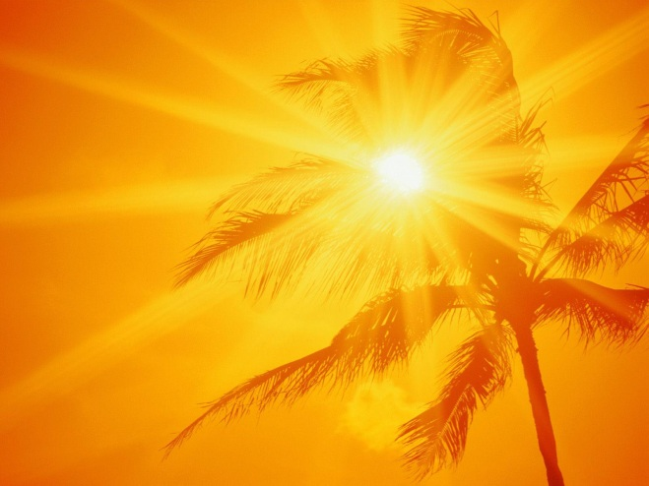
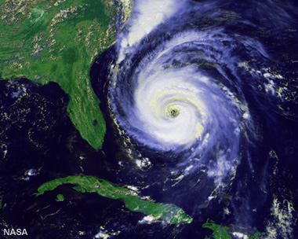
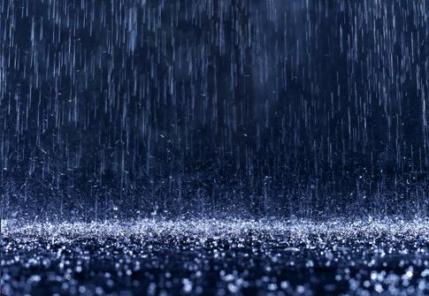
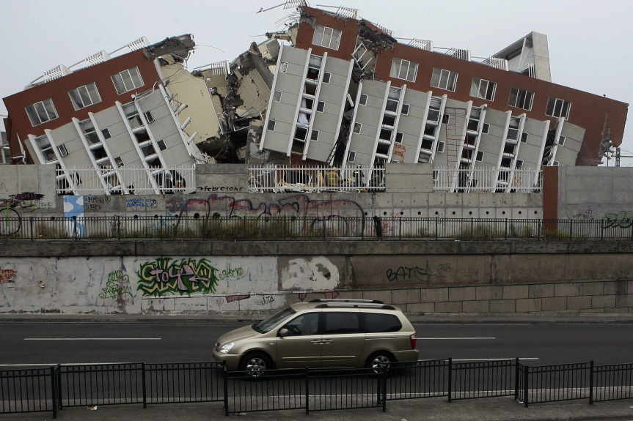
Which of these are NOT weather?
TORNADO
earthtimes.org/climate/devastating-start-us-tornado-season-warning/1860/
SNOW
en.wikipedia.org/wiki/File:UK_snow_February_2,_2009_img008.jpg
TSUNAMI
THEATLANTIC.COM/INFOCUS/2011/03/JAPAN-EARTHQUAKE-AFTERMATH/100023/
WILDFIRE
HTTP://WWW.THEATLANTIC.COM/INFOCUS/2011/09/MORE-TEXAS-WILDFIRES/100141/
SUNNY
HURRICANE
RAIN
EARTHQUAKE
bosunbrian.blogspot.com/2012/07/where-is-sunshine.html
http://geology.com/hurricanes/hurricane-names.shtml
http://nowiknow.com/making-it-rain/
HTTP://WWW.RNW.NL/ENGLISH/ARTICLE/NETHERLANDS-300000-CHILEAN-EARTHQUAKE
Notes:
Some of these pictures are weather, and some are not. Take a minute and talk with your neighbors and decide which pictures are weather, and then we’ll discuss it together. Weather images: Tornado, Sunny, Hurricane, Rain, Snow. [Give them a minute to pair-share, then go through the pictures together. Share a few fun facts about tornadoes, tsunami, etc. The non-weather images will disappear as you click. Help them understand why they are not weather, some may be caused by weather, but are not actually weather.]

Slide 5
Which one of these do we NOT see in Idaho?
WHY?
Hurricane
Sunny
Snow
Tornado
Rain
Notes:
Which of these do we have in Idaho? (Give them some time to think about their answer. Explain why we do not have hurricanes. They need large bodies of water to form in tropical or subtropical areas. . Do we have a warm ocean near Idaho? No.)

Slide 6
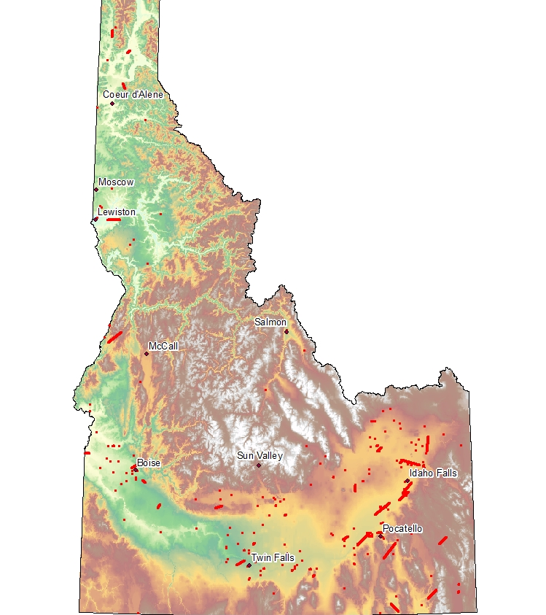
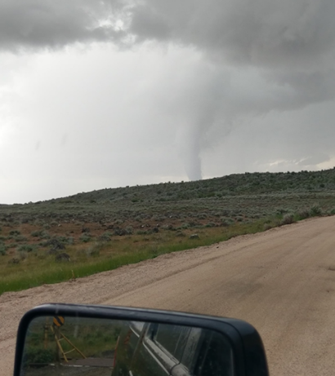
Tornadoes in Idaho
1950 - 2014
MOUNTAIN HOME, ID
May 27, 2019
Notes:
Yes we do get a few tornadoes in Idaho! Here is a map that shows where tornadoes in Idaho have occurred (red dots). Luckily with our mountainous terrain, we only get on average 1 to 2 tornadoes a year in the entire state. Some states, like Texas, get 100-500 tornadoes in a year! The area of the Midwest known as Tornado Alley gets the most tornadoes because that is where the cool dry air from the Northwest meets the warm moist air from the Southeast and there’s a lot flat land for the funnel cloud to touch down. Winds in a tornado can reach over 300 mph! We will talk more about what causes wind soon. If you want your class to learn more about tornados you can watch this youtube form National Geographic https://www.youtube.com/watch?v=ztlnZRp1WiE

Slide 7
WEATHER
The current conditions in the atmosphere.
Notes:
You have a sense of what is weather and what is not, but what makes something weather? Well it all has to do with where weather happens. Weather is the current conditions in the atmosphere at a particular place and time. It’s what’s happening outside right now.

Slide 8
What Creates weather?
Notes:
What creates weather? We are going to investigate this question today.

Slide 9
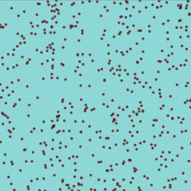
AIR
OUR ATMOSPHERE IS MADE UP OF …
Notes:
What is the atmosphere made up of? AIR.
Air has weight because it is composed of gases. Do you remember learning about the three phases of water in the water cycle? Water vapor is one of the gases in the atmosphere (like the steam you see when you boil water). Another type of gas is called oxygen, which is important because that is what we breathe!
These gases are made up of teeny tiny particles called molecules. (click on slide to display figure with red dots). Molecules are so tiny we can’t even see them with a regular microscope, but the atmosphere is full of them! Moving molecules in gases can be kind of pushy! In fact, did you know that molecules in the atmosphere are pushing on you right now?

Slide 10
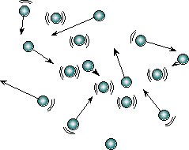
Molecules have
weight and create pressure
Notes:
Every inch of your body has about 15 pounds of air pushing on it. We call that PRESSURE. (Have students demonstrate pressure to themselves by pushing their hands together.)

Slide 11
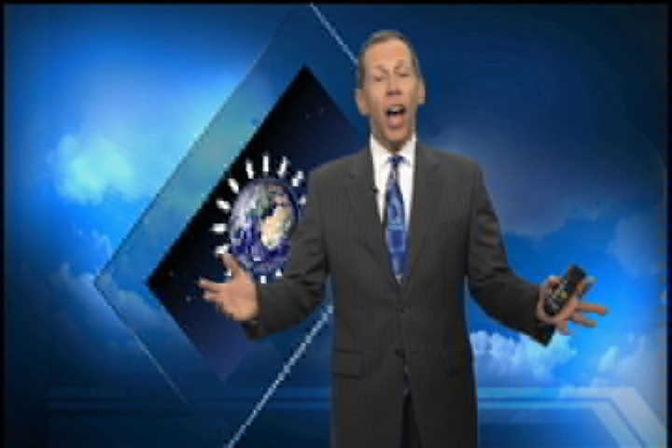
AIR PRESSURE
Notes:
Now that you’re air pressure experts, let’s hear from a local weather scientist, Scott Dorval, about how pressure creates different weather patterns. Play movie clip about pressure [Now is generally a good time to put the soda cans on the hot plate and turn it on.]
As Scott Dorval said, air is causing pressure in all directions. Let’s see
what these little molecules can do! This experiment is going to take place
in the front of the room, so if you’re in the back rows, feel free to come sit
on the floor in front. I call it ‘the Splash Zone!’
Can crusher demo: Hold up a cool empty can. Is this can empty? It looks empty, but remember, there are gas molecules in it, and they are being pushy and creating pressure. There are molecules pushing on the outside and molecules pushing on the inside. If I put pressure on this can with my hands, I could crush it, but do you think air can put enough pressure on this can to crush it?
We can demonstrate pressure by pushing your hands together. Your arms are like the molecules in the air pressing on the outside of the can and from the inside of the can. But if we were to all of a sudden remove the molecules on the inside, (move one arm away) the molecules on the outside will move the side of the can.
Turn to the can on the hot plate. This can had a tiny bit of water in the bottom, but we have boiled it off, so know the can is full of water vapor gas. Think back to the water cycle. When I cool the can off in the cold water, what is going to happen to the water vapor? The important thing to know is that I’m going to remove the air molecules from inside of the can. This is like when the student stepped away. What will happen to the can? Turn to your neighbor and make a prediction. Flip the can into the ice water and let it (hopefully) implode. Whoa! What crushed the can? When we cooled off the water vapor in the can, we basically took the gas molecules out of the can. The molecules in the air outside the can crushed it! I can exert pressure with my hand to crush a can, but air can also exert pressure. Air has weight, and it can be pushy (cause pressure)!]

Slide 12
COLD Air Weighs MORE!
HOT
Air Weighs LESS!
Notes:
We know that the atmosphere is full of tiny gas molecules that are moving around, but how fast they move around depends on their temperature. Imagine we have a column or box full of air molecules. Now imagine we have a column full of colder air molecules. Molecules in cold air don’t move as fast, and stay closer together. [Click back and forth between the green molecules and cold blue molecules.] Which column do you think weighs more? [Click again.] Cold air weighs more. Now what if we had a column of warmer molecules. Molecules in warm air move faster and spread apart. (You can make an analogy about hot sweaty people wanting to stand far apart, and cold people wanting to huddle close together.) Because the molecules are spread out, warm air doesn’t weigh as much as cold air. [Click again.] Cold air weighs more, warm air weighs less.
Let’s demonstrate the difference between cold and warm air. We’ll use water instead of air so we can see it.
Hot and Cold Demo: Place the four glass jars on the cookie sheet. Put two drops of blue food coloring in two of the jars (if you haven’t already). Pour cold water into these jars. Put two drops of red food coloring in the other two jars (if you haven’t already). Pour hot water from the kettle in these jars. Place one plastic disc on top of one of the cold water jars. Carefully invert the jar and place it on top of one of the red jars. Explain that you are going to remove the disc and let the hot and cold water come in contact with each other. Have the students make predictions about what will happen. Quickly remove the disc and let the waters mix. Have students offer their explanations. Repeat the demonstrations with the other two jars, but place the hot water on top of the cold water. Why do you think this happened?
We’ve learned that cold air is heavier than warm air. Air moves around depending on its temperature. Can you think of a type of weather that happens all the time that is caused by air moving around?

Slide 13

HOT AIR AND COLD AIR
Notes:
Wind! And if we get the perfect combination of hot moist air and cold dry air, we can get tornados, which we talked about earlier!

Slide 14
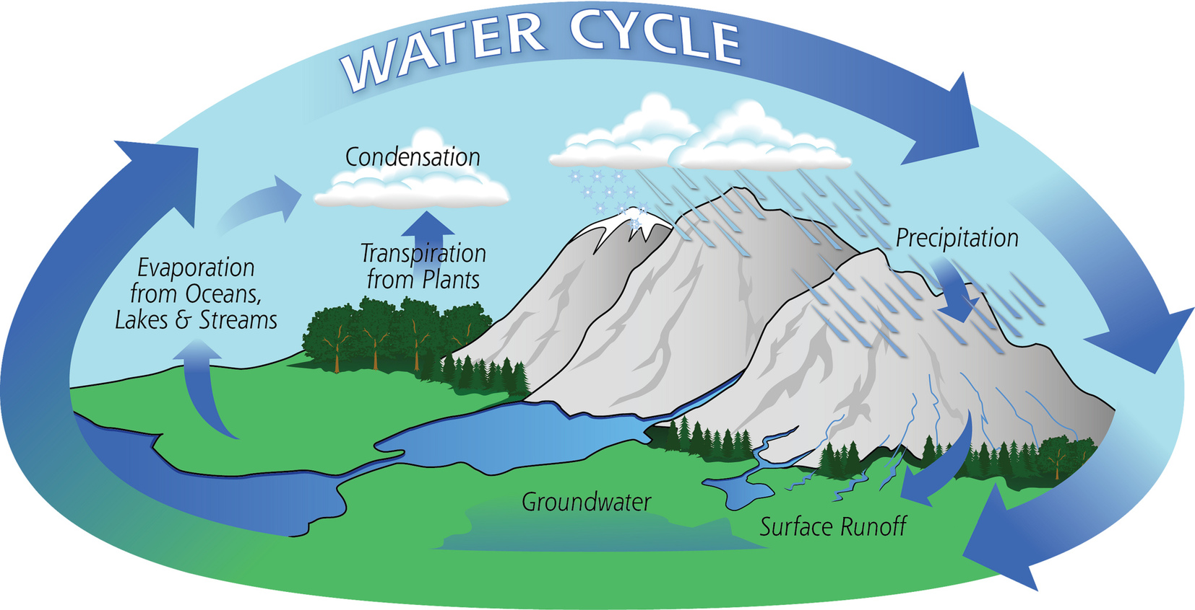
Notes:
So far, we’ve talked only of air molecules relating to weather conditions. However, not only does air move around the atmosphere, but water is also constantly moving around the atmosphere as part of the water cycle. Clouds and precipitation are part of the water cycle. How would you explain evaporation? How would you explain condensation? How would you explain precipitation? How are temperature and the sun important for the water cycle? Emphasize that energy from the Sun and temperature changes move water around in the atmosphere.

Slide 15
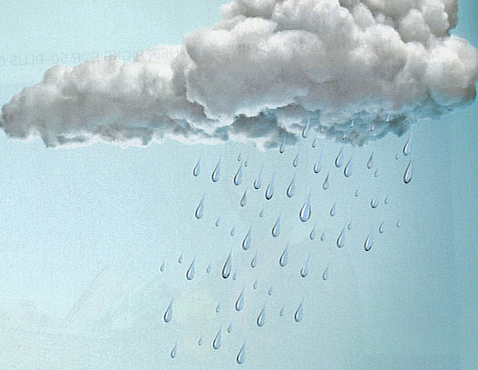
What’s going on in the atmosphere?
Molecules have weight and create pressure
Air moves around depending on its temperature
Water is moving through the water cycle
A perfect recipe for WEATHER!
Notes:
Let’s summarize what we’ve learned so far about what causes weather in the atmosphere. [Click through key points.] We know that the atmosphere is made up of molecules that have weight. These molecules are pushy and can create pressure. Pressure and temperature differences move air around the atmosphere. Also, the water cycle moves water around the atmosphere.
When we combine air and water moving around the atmosphere, we have weather. Weather is current conditions in our atmosphere at a particular time and place. Do you think that you can make predictions about the weather? I think you can make some predictions based on what you already know.

Slide 16
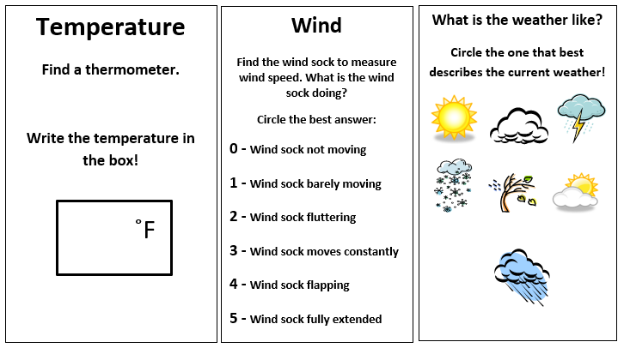
Weather Notebook
Notes:
You are going to be a meteorologist now and write in a scientific notebook. What is a meteorologist? A meteorologist is an individual with specialized education who uses scientific principles to observe, understand, explain, or forecast phenomena in Earth’s atmosphere and/or how the atmosphere affects Earth and life on the planet.

Slide 17
Time to make some weather observations!
Grab your pencil and meteorology notebook
Observe the weather and use the thermometer and windsock
Record the weather conditions you see and feel in your notebook
You’ll have 5 minutes to complete this activity.
Notes:
Have the students pull out their clipboards and notebooks. Have them write their names on the blank line on the first page. In a moment we’ll be going outside to feel what today’s weather is like. We’ll be using a thermometer to help us tell the temperature. (show them the thermometer example and show them how to take a temperature reading) The thermometers we’ll be reading look like this. Follow the big red dial to read the temperature in degrees Fahrenheit. Each black dash counts by 2 degrees.

Slide 18
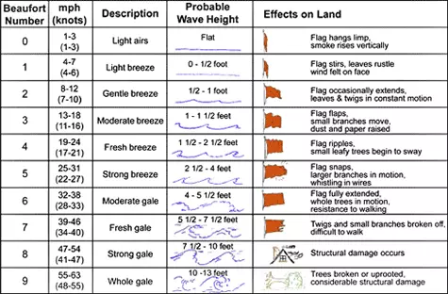
Beaufort Wind Scale
This number is based on observation and not a measurement.
Notes:
We’ll also be estimating wind speed based on our observations of windsocks. We’ll use the Beaufort scale to observe if the wind sock is moving. Beaufort Wind Scale: This scale was developed by the Royal Navy in order to help sailors determine the strength of the wind. It goes on a scale of 0-12. 12 being hurricane force level of winds. The reading is taken by observing something. Flags, wind socks, or tree branches on land. Ocean waves or sails on the sea. Now most places in the world use mph/kph to determine wind speeds, but the Beaufort Scale is still relevant due to its ease of use and not needing an instrument to get a reading.
Walk outside, have students read thermometers, record the temperature in their notebook. Observe the wind socks and circle what the wind sock is doing. Instruct them to circle the picture(s) that describe today’s weather. Walk around and assist students as needed. If there is time, have one student share his/her forecast.

Slide 19
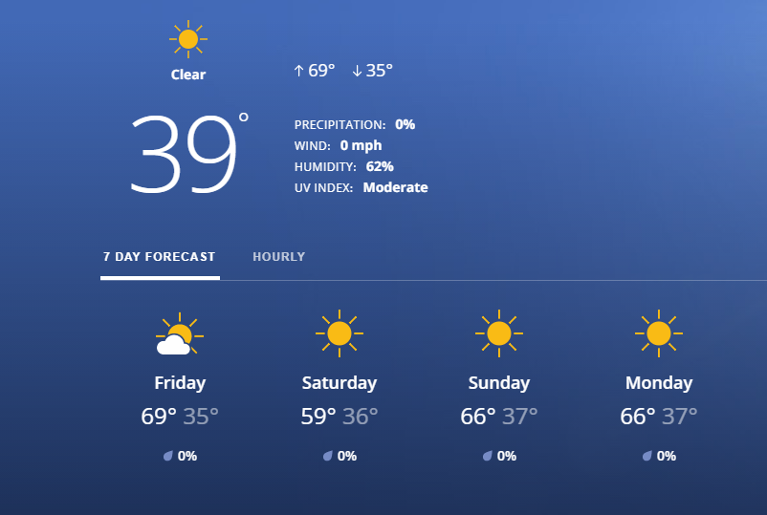
What were your weather observations?
Let’s compare with the local weather forecast.
Notes:
Lets compare what we observed to the local weather forecast for today. Use the link to go to Idaho News or use your favorite weather forecast organization. Note that student observations may vary from the weather data reported on the news due to many factors such as location, distance from a building, concrete heat islands and the microclimates they create.

Slide 20
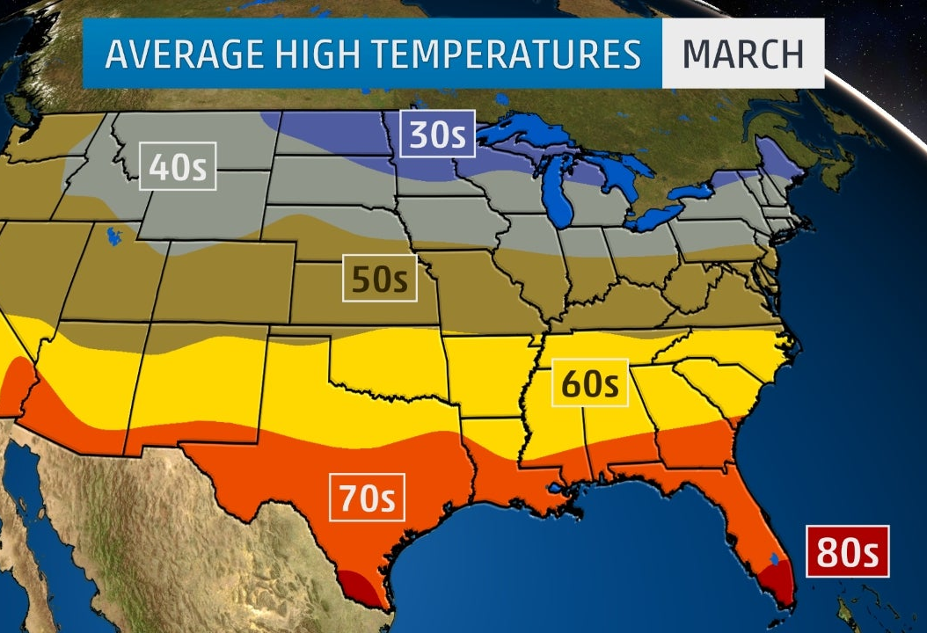
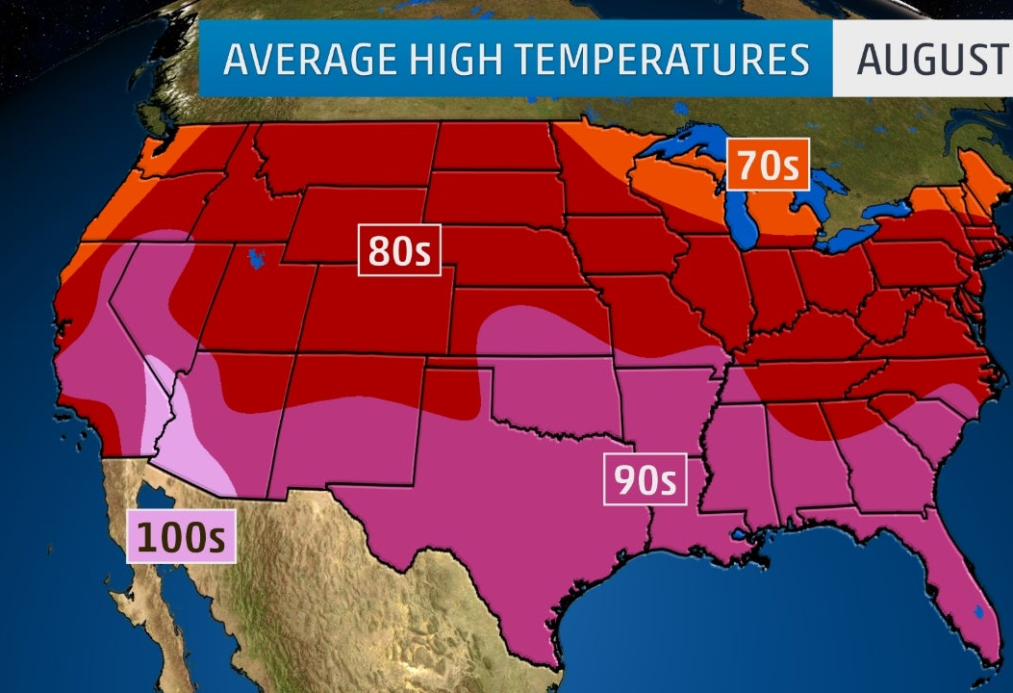
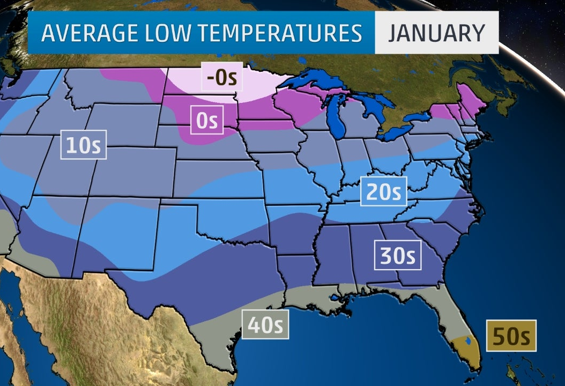
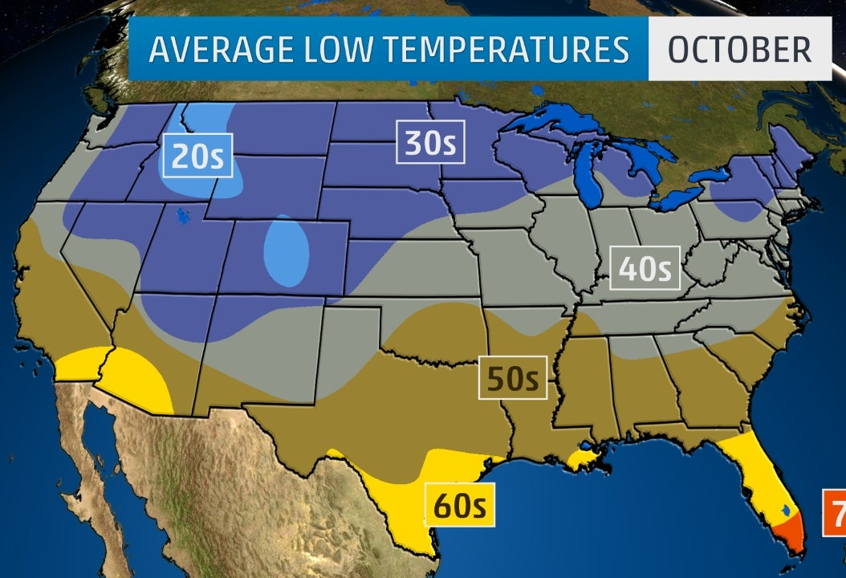
Temperature on a Weather Map
Notes:
Meteorologists make forecasts that look like this. They make predictions about weather in the next few days. Sometimes meteorologists display weather information on maps like these. Can you observe some of the differences between these maps? Student responses may include: the maps correlate to different months of the year with the warmest temperatures in August and coldest temperatures in January.

Slide 21
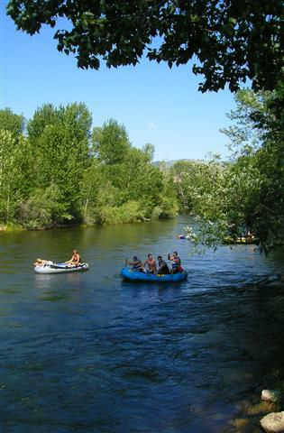
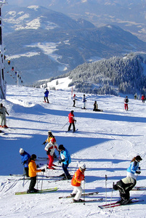
Weather changes with the SEASONS!
Notes:
As you know living in Idaho, there is a big difference in temperature between January and August! For example, you wouldn’t want to float the river in the winter, and you can’t go skiing at Bogus Basin in the summer.

Slide 22
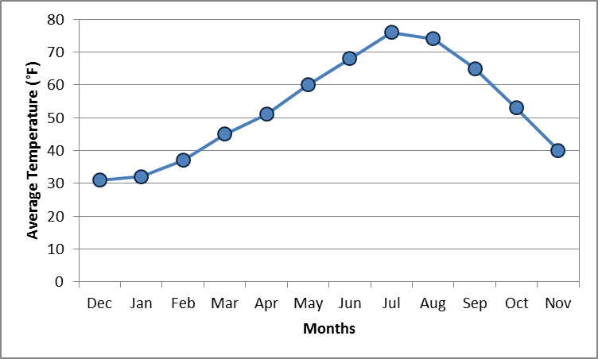
Seasons on Graphs!
Winter
Spring
Summer
Fall
Notes:
This is because Earth has four seasons, and each season has different weather. Seasons are periods of the year characterized by particular weather conditions. Look at the page in your meteorology notebook with the graph. By looking at how the temperature changes can you make a guess about which season goes in each box? Have students fill in their guesses and then click to reveal the seasons. If you want to use the season sort cards this is a great time to pass them out and have students sort them into each season.

Slide 23
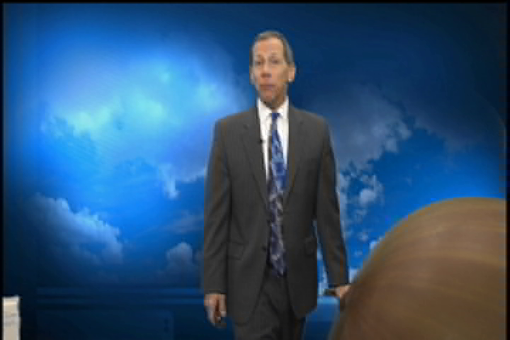
Weather Instruments
Measure Conditions
Notes:
How do meteorologists forecast the weather? They use information, or data, from weather instruments. Let’s watch another short video by meteorologist Scott Dorval. Play Movie clip. The radiosonde and weather balloon occasionally are found by people in their backyard or out hiking. After it travels over 100,000 feet (19 miles) high through our atmosphere, the balloon eventually pops and the instrument falls to the ground with a parachute. Here is one that was found last summer and returned to the National Weather Service, who gave it to us to share it with you. The radiosonde has a barometer, or pressure sensor inside, it also has a temperature (long wire probe) and humidity (short spoon-looking object) sensor. There is a GPS tracker that maps the distance and height in the atmosphere which can give us wind speed and direction. On the inside is a battery and transmitter so that the computers will receive the data. The latex balloon is five feet in diameter, but inflates to a much larger size. The parachute is what carefully allows it to land, making it reusable if someone finds it and turns it back in.

Slide 24
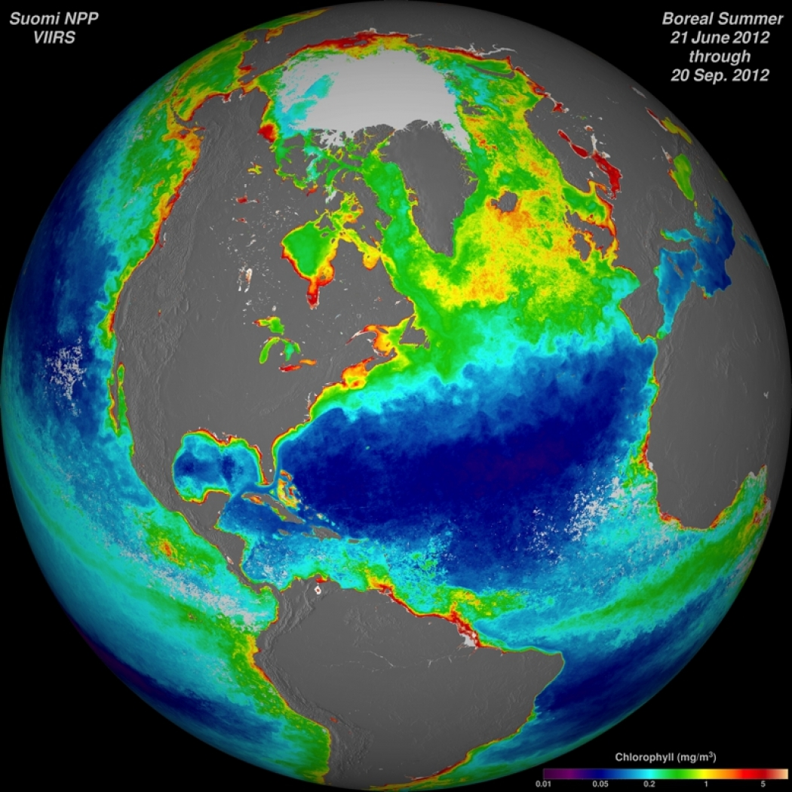
Meteorologists are weather and climate scientists.
Notes:
Meteorologists are studying weather and climate. But what is climate?

Slide 25


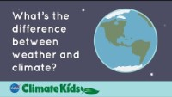
WHAT IS CLIMATE?
Notes:
Weather is a specific event—like a rainstorm or a hot day—that happens over a few hours, days or weeks.
Climate is the average weather conditions in a place over 30 years or more. Climate is the long-term (ranging from months to millions of years) weather patterns in an area, which include average precipitation and temperature extremes. Watch this video about the difference between weather and climate

Slide 26
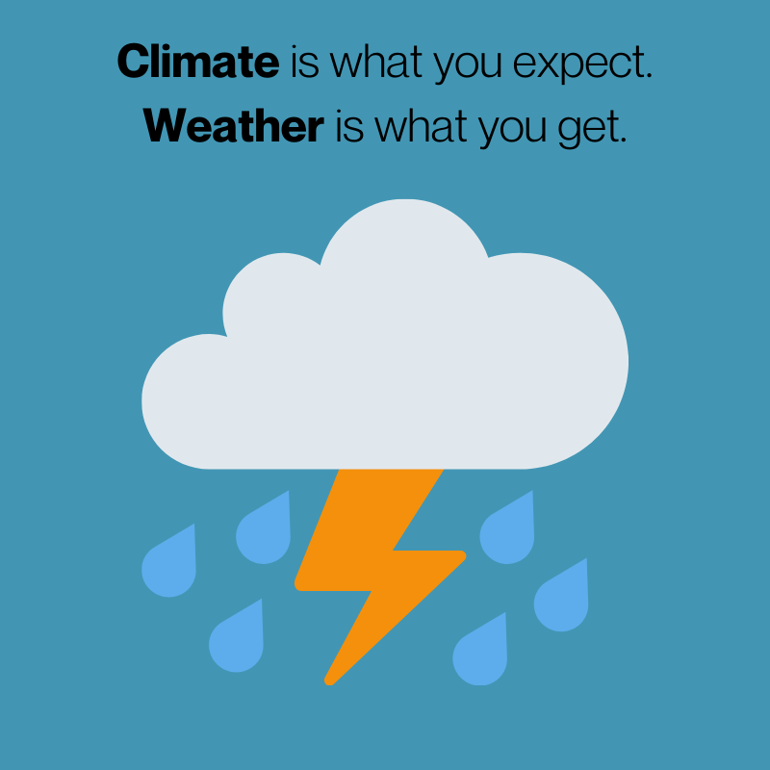

Slide 27
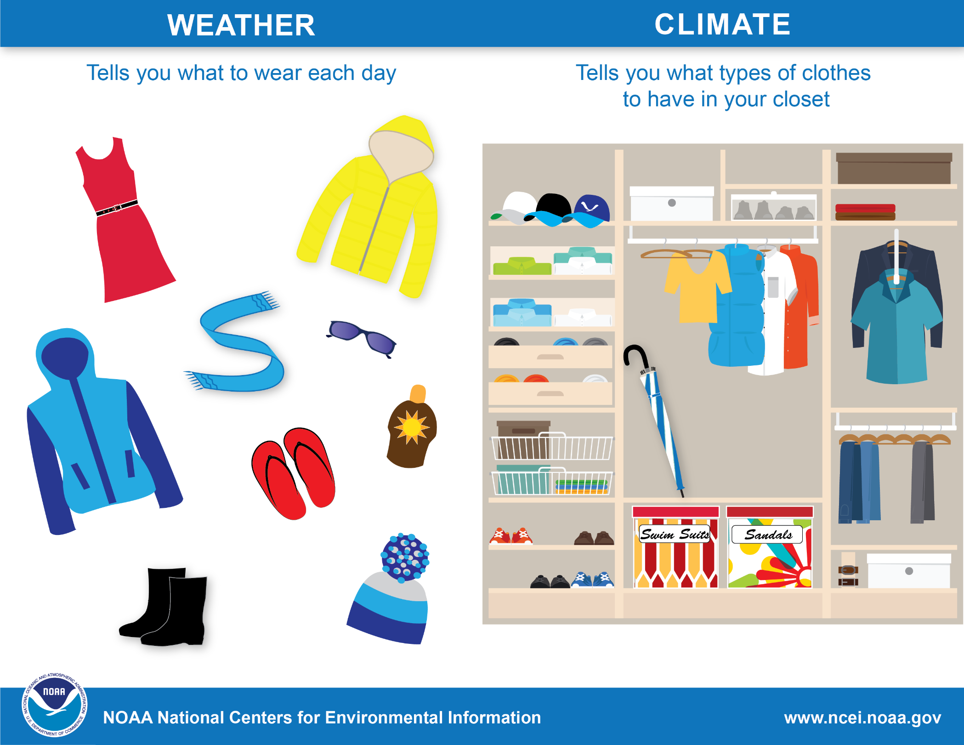

Slide 28
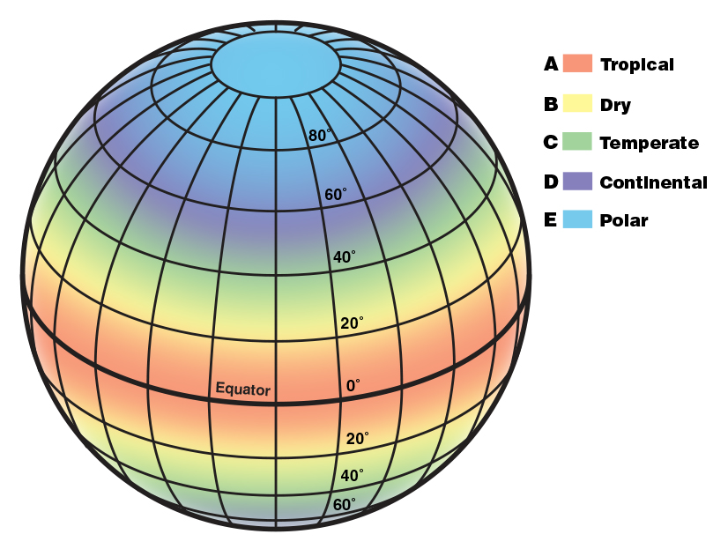
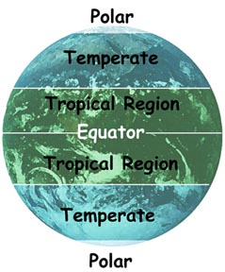
Climate Zones
Notes:
There are approximately five main climate types on Earth:
Tropical
Dry
Temperate
Continental
Polar
If you want to dive deeper into climate zones here is a little extra information from NOAA.
A: Tropical. In this hot and humid zone, the average temperatures are greater than 64°F (18°C) year-round and there is more than 59 inches of precipitation each year.
B: Dry. These climate zones are so dry because moisture is rapidly evaporated from the air and there is very little precipitation.
C: Temperate. In this zone, there are typically warm and humid summers with thunderstorms and mild winters.
D. Continental. These regions have warm to cool summers and very cold winters. In the winter, this zone can experience snowstorms, strong winds, and very cold temperatures—sometimes falling below -22°F (-30°C)!
E: Polar. In the polar climate zones, it’s extremely cold. Even in summer, the temperatures here never go higher than 50°F (10°C)!

Slide 29
Today we learned:
What is weather and climate
Where weather happens
What a meteorologist is
Where the 5 climate zones occur
Made weather observations
Weather changes with the seasons
Notes:
Recap what students have learned, ask them or have them discuss with a neighbor. Was there anything you learned today that surprised you?

Slide 30
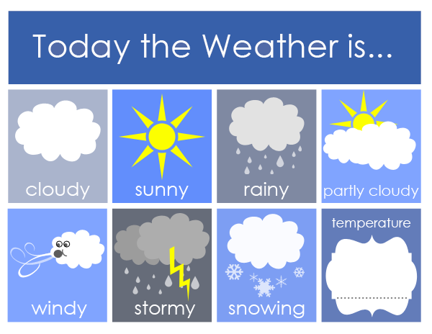
Questions or Comments about what you learned today?

Slide 32
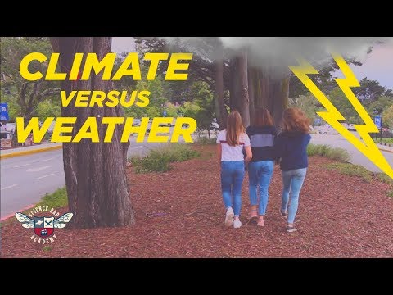
WEATHER VS. CLIMATE
Notes:
Video made by students from Nueva School about the difference between Weather and Climate as well as an intro to climate change. https://youtu.be/87P0G_9aK2c
3 min 10 seconds

